Slide 1
CAFÉ CHAIN
Exploratory Analysis
By
Hari Haran
04th April 2024

Slide 2
Problem Statement
The data set provided to you is the data set of a Café Chain for one of its restaurants. Do a thorough analysis of the data and come up with the following analysis. The owner of the restaurant wants you to use this data to come up with a set of recommendations that can help his Café Chain increase its revenues. He is able to provide you with a data set for POS (point of sale data) for one of his chains.
Data Set - Cafe_Data_MRA (10) (1).xlsx

Slide 3
Data Set - Summary
Understandings from the given data
The given data contains 11 columns and 145830 rows.
The given data has date and bill of the date corresponding various items and their category like food, beverages, tobacco, etc.
The data is POS of one of the café of a café chain given by the owner, which has been collected over a period of 11 months .
The data also includes quantity sold, their corresponding rates, tax, discounts and the total revenue.
The data also contain time of sales for each day over the given period of time, indicating various selling hour over a week.

Slide 4
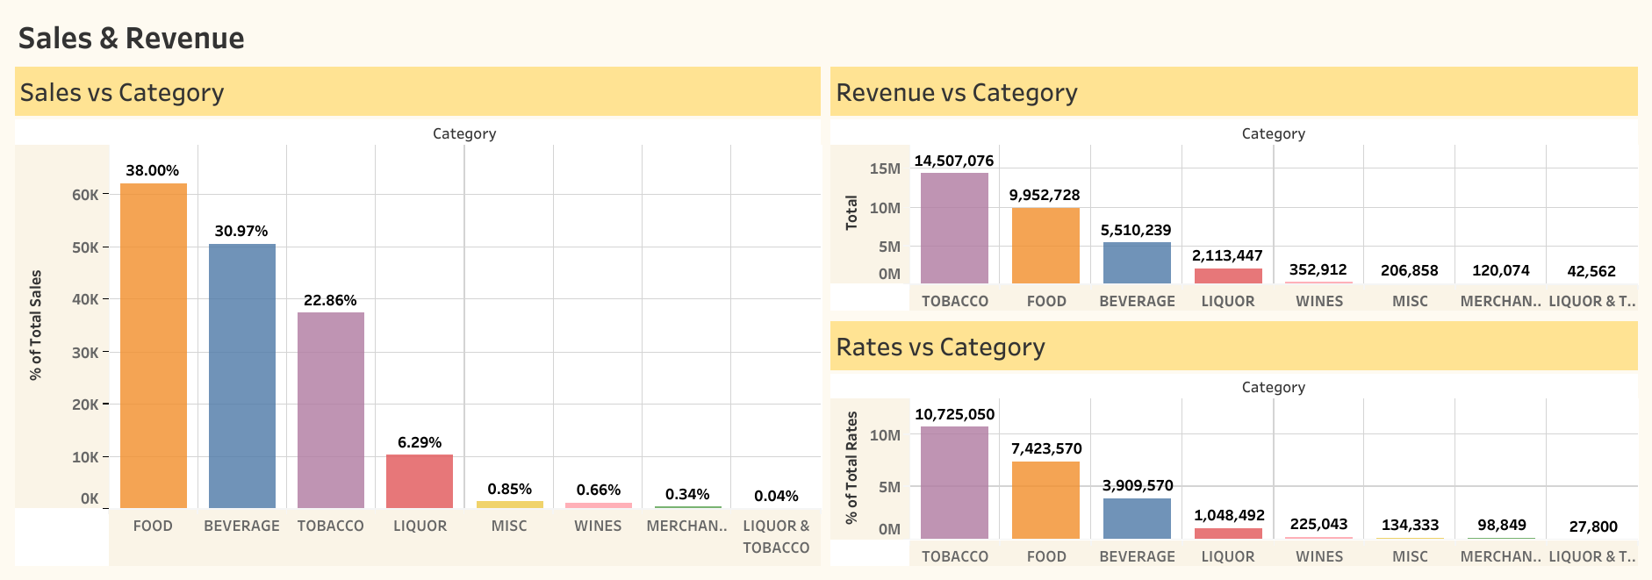
Top Sales Food
Top Rates Tobacco
Top Revenue Tobacco
Food Sales = 38%
Tobacco revenue = 14,507,076
The above graph shows the quantity of items sold in each category with their individual rates and total revenue generated by them.

Slide 5
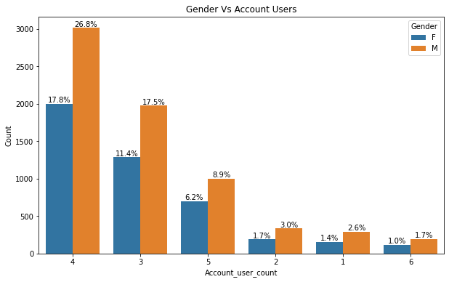
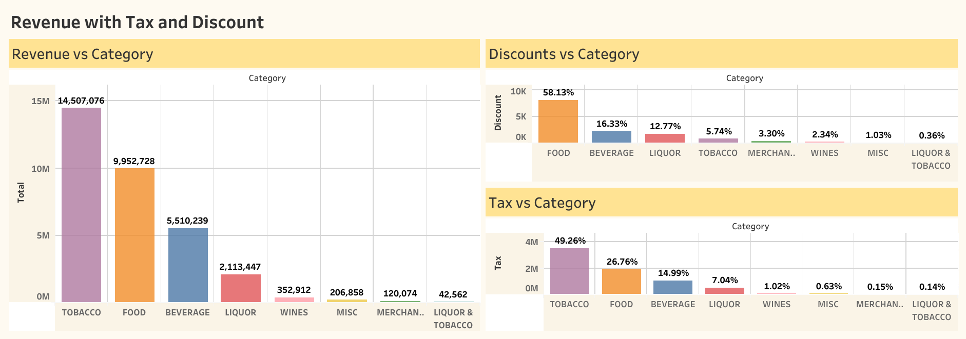
Highest Tax Rates Tobacco
Highest Discount Rates Food
Although Tobacco is the highest revenue generating category, its tax is also the highest compared to food and beverage.
Food discount is highest among all the other categories.

Slide 6
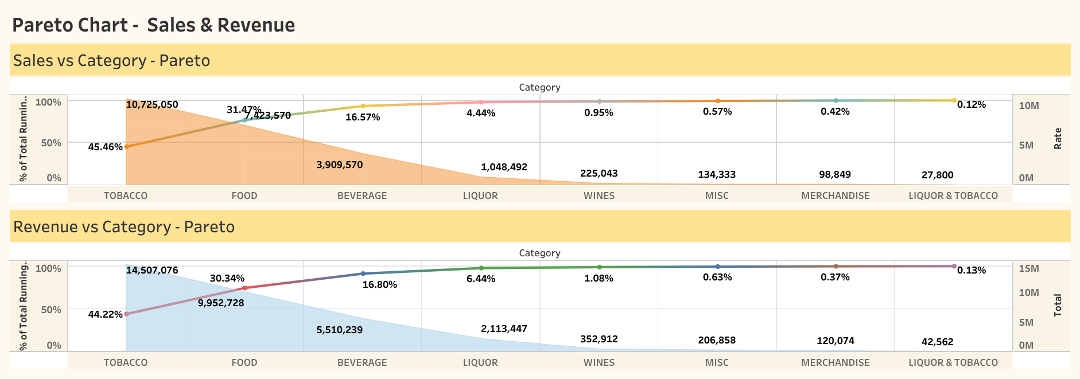
Tobacco with Highest Running Total
Revenue Running Total of tobacco = 44.22%
Rate Running Total of Tobacco = 45.46%

Slide 7
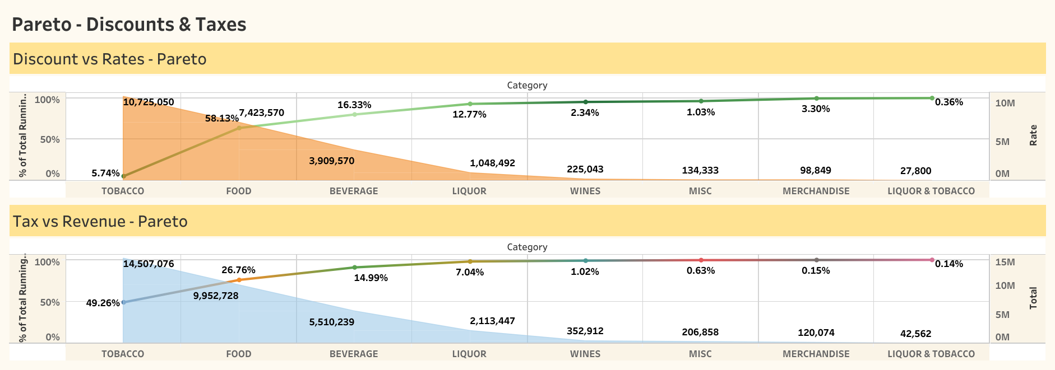
Highest Running Total in Tax Tobacco
Highest Running Total in Discount Food
Tax Running Total of Tobacco = 49.26%
Discount Running Total of food = 58.13 %

Slide 8
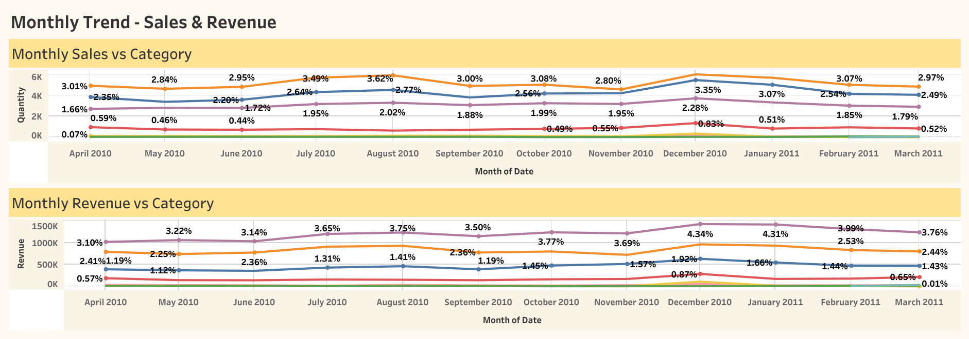
High Rev. Generating Months July to Sep & Nov to Feb
Highest revenue generated Running total in December for tobacco = 4.34%
Highest Revenue Generating items = Tobacco >> Food >> Beverages >> other categories
Peak in the trend observed in between November to February. It may be due to the festive seasons.

Slide 9
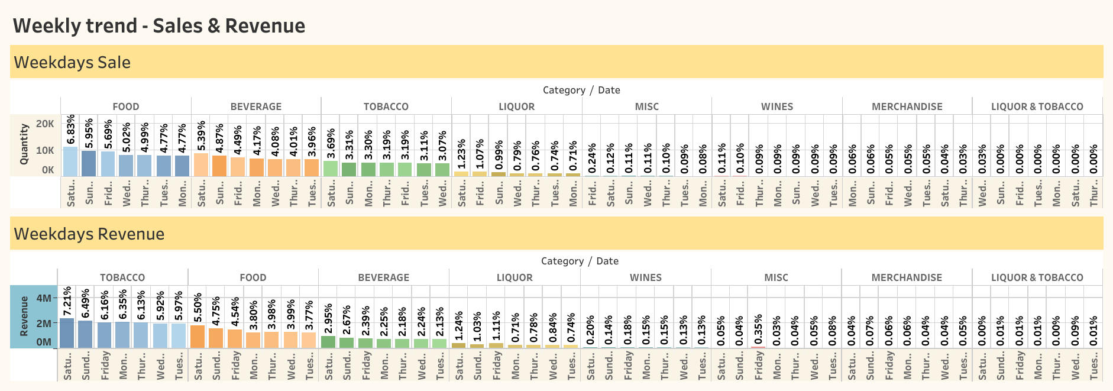
High Rev. Generating Day Saturday & Sunday
Highest revenue generated Running total on Saturday for tobacco = 7.21%
Highest Revenue Generating items = Tobacco >> Food >> Beverages >> other categories
Peak of sales observed on Saturday & Sunday = Food >> Beverage >> Tobacco >> other categories

Slide 10
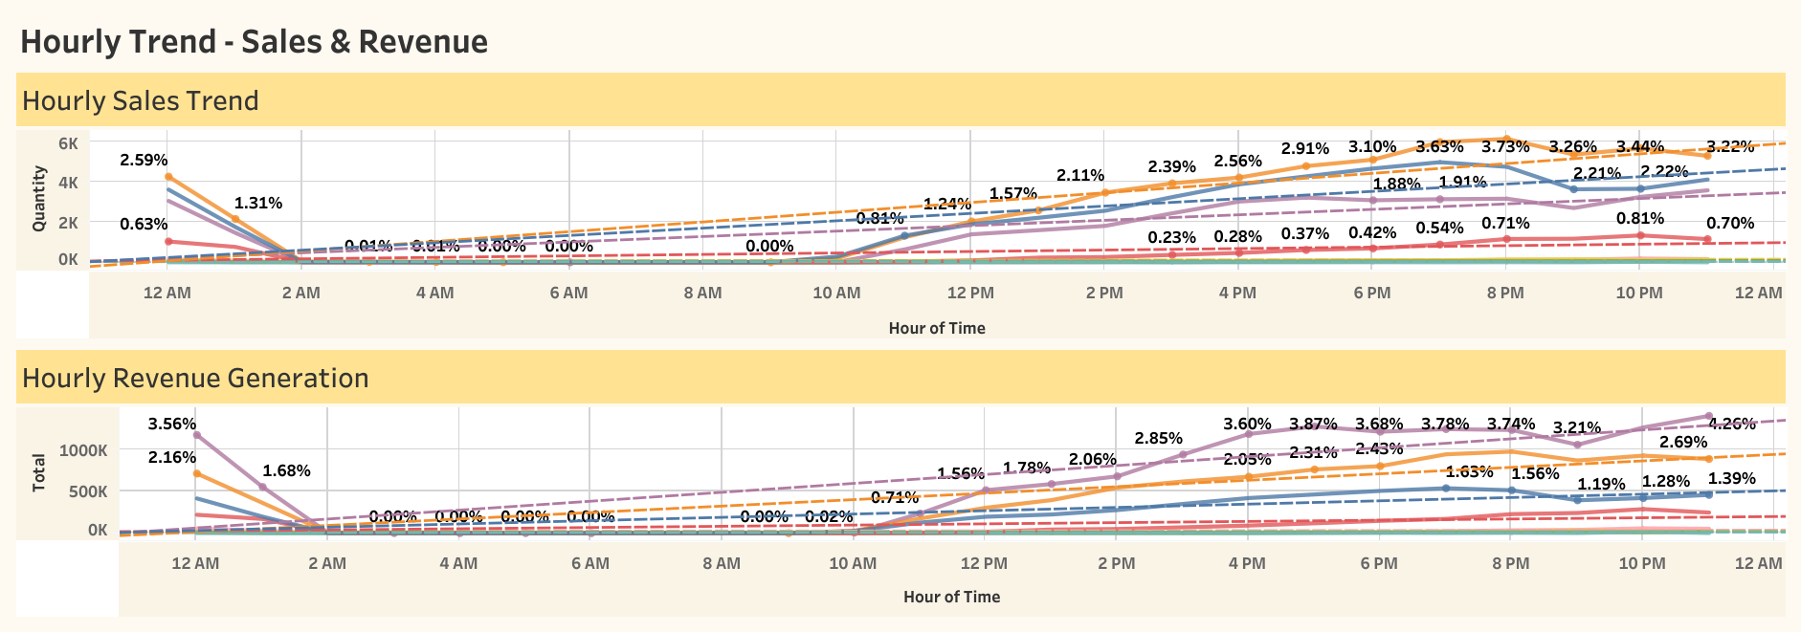
Highest Rev. Generating Hours Between 10 pm to 12 am
Highest revenue generated Running total = 4.26% between 11 pm to 12 am
Not much sale observed after 12 am to morning 10 am
Best-selling hours = 4 pm to 12 am

Slide 11
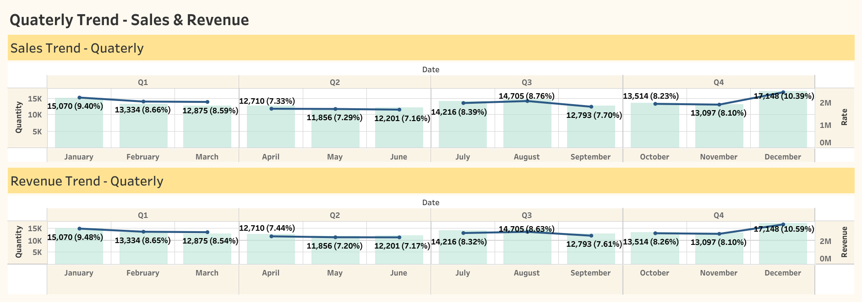
Highest Rev. Generated Quarterly Q1 and Q4
Highest Revenue Generated Quarterly Running total = 10.59 % in Q4 (December)
Highest Rev. Generating Quarters = Q1 & Q4
Highest Sales Quarterly Running total = 10.39 % in Q4 (December)
Highest Sales Quarterly = Q1 & Q4

Slide 12
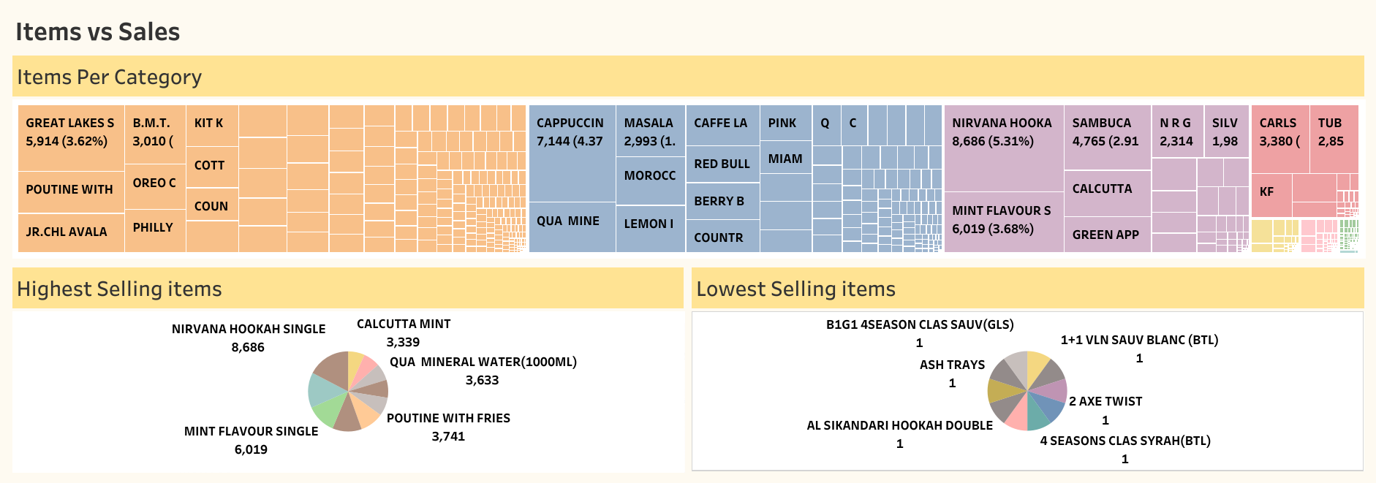
Items in each category with their Quantity
Quantity of Items in Each Category = Food >> Beverages >> Tobacco >> Others
Highest Selling Item is in Tobacco Category, Nirvana Hookah Single = 8686
Lowest Selling items (on the right-hand side) are very low in quantity

Slide 13
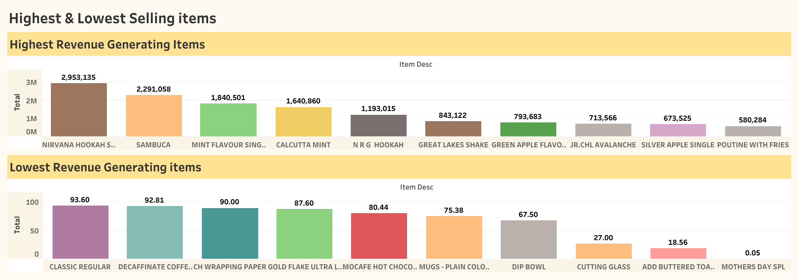
Top 10 Items – Highest and Lowest Rev. Generating
Highest Revenue Generating item is Nirvana Hookah (Tobacco) = 2,953,135
Lowest Revenue Generating Item is Mothers Day Spl = 0.05

Slide 14
Exploratory Analysis- Summary
Sales & Revenue Generation : Although Food being the highest selling category = 38 % , Tobacco is generating the highest revenue generating item followed by food . Tobacco Revenue = 14,507,076
Tobacco has the highest Revenue but also, it's taxed the highest compared to food. The discount in food is more than Tobacco, beverage and liquors. Tobacco tax = 49.26 % & Food tax = 26.76 %
Tobacco has the highest revenue which has the running total of 44.22 %, with highest rates (price) of 45.46 % of running total. Second is the food category = 30.34 % and then it’s beverage = 16.80 %.
Food has the highest discount of 58.13% running total compared to tobacco of only 5.74%.
Monthly Trends - Indicates increase in sales of food, beverage and tobacco between July to August and highest in December to slowly declining in January.
Weekdays trend - Indicates highest selling during weekends ,i.e., Saturdays and then Sundays for almost all the categories.
Hourly Trend - Indicates higher selling during the late hours of the day. Mostly from 10 pm to 12 am. No sale after 12 am till 10 am in the morning.
Quarterly Trend - The quarterly sales indicate good sales in the beginning of Q1 and at the ending of Q4. Q1 and Q4 being the highest time of the year generating most revenue and sales.
Food Category has the highest items followed by Beverages and Tobacco. Nirvana Hookah Single is the most sold item. Least performing items are lowest as it's sold not more than once.
In top 10 Most Performing Item, Nirvana Hookah Single generates the highest revenue. While Mothers Day Spl is the lowest performing item in the bottom 10 least performing item. It looks like its rarely sold.

Slide 15
Exploratory Analysis- Summary
Remove
Bottom 10 Least Performing items can be dropped as they are contributing very less to the total revenue generation.
Happy Hours
Evening hours from 4pm to 6pm can be used as happy hour – Slot 1. From 7 pm to 9 pm can be another hour for the same – Slot 2.
Breakfast
Café can introduce items for breakfast from 8 am to 10 am and lunch from 12 pm to 2 pm.
Discount
Discount on food should be reduced. Food discount can be issued for morning hours.
Offers
Offers on weekdays like combo meals. Offers for Q2 and Q3 quarters aligning with festivities can also introduced.
Menu
Business is mostly dependent on Tobacco category sales. Business must introduce more food and beverage items. Even liquor items specially for weekends can be introduced.
Menu
Café can introduce more beverages for hot seasons that’s between Q2 and Q3 with combo meals.

Slide 16
CAFÉ CHAIN
Menu Analysis
Market Basket Analysis - KNIME

Slide 17
Market Basket Analysis
ASSOCIATION RULE:
Association rule is used to find association and relationship among various items in a large data set.
This rule shows frequency of various items present together in transaction (or item bills). Based on this transaction and occurrences an association is created of the chance of an item A present with item B.
Given a set of transactions, we can predict the occurrence of an item based on the occurrences of other items in the transaction, which is conditional probability.
Conditional probability is the probability of an event happening given that another event has already happened.

Slide 18
MEASUR ASSOCIATION RULE:
SUPPORT – It is the frequency of item A bought along with the combination of item B bought by the user in the same transaction. It is the measure of how frequently the collection of items occur together as a percentage of all transactions
Support = freq (A)/N
Support = freq (A,B)/N ,
where N = Number of transactions and freq = Number of transaction in which A appears (or) A and B both appears.
CONFIDENCE – It denotes how often A and B occur together given the number of times A occur one after the other. The use of confidence is to find when the customer buys A & B but not C frequently, then we can eliminate the association rule.
Confidence = freq(A,B)/freq(A)
LIFT – It denotes the strength of any rule. We use lift to determine the occurrence of randomness rather than the association and eliminate the rule.
Lift = Support/Support(A)*Support(B)
Market Basket Analysis

Slide 19
Market Basket Analysis
Items + Combos | Sum of Support | Sum of Confidence | Sum of Lift
ADD HERB ROAST CHICKEN | 0.001 | 0.178 | 79.364
[LEMON INFUSED CHAR GRILLED VEG] | 0.001 | 0.178 | 79.364
B.M.T. PANINI | 0.005 | 0.619 | 16.624
[ADD FRIES] | 0.002 | 0.201 | 5.394
[FRENCH FRIES] | 0.001 | 0.266 | 7.144
[MAGGI NDL ARRABIATA] | 0.002 | 0.152 | 4.086
BERRY BLAST | 0.002 | 0.143 | 4.911
[COOL CALIFORNICA] | 0.002 | 0.143 | 4.911
CAFFE LATTE | 0.002 | 0.546 | 18.235
[ADD HAZELNUT FLAVOUR] | 0.002 | 0.546 | 18.235
CALCUTTA MINT | 0.005 | 0.249 | 5.274
[RED BULL 2+1] | 0.002 | 0.142 | 3.010
[RED BULL ENERGY DRINK] | 0.003 | 0.107 | 2.264
CAPPUCCINO | 0.015 | 1.248 | 15.970
[ADD HAZELNUT FLAVOUR] | 0.001 | 0.464 | 5.936
[CAFFE LATTE] | 0.004 | 0.142 | 1.814
[DOPPIO] | 0.001 | 0.149 | 1.905
[ESPRESSO] | 0.001 | 0.166 | 2.125
[MASALA CHAI CUTTING] | 0.004 | 0.112 | 1.438
[THE CHOCO LATTE] | 0.001 | 0.112 | 1.435
[ULTIMATE HOT CHOCOLATE] | 0.002 | 0.103 | 1.317
Following are the items found that are best combos after applying association rule :

Slide 20
COUNTRY ROAST CHICKEN PANINI | 0.001 | 0.116 | 6.124
[ADD FRIES] | 0.001 | 0.116 | 6.124
GREAT LAKES SHAKE | 0.014 | 1.107 | 15.898
[B.M.T. PANINI] | 0.004 | 0.109 | 1.561
[COTTAGE CHEESE PANINI] | 0.002 | 0.107 | 1.542
[GARDEN FRESH PANINI] | 0.002 | 0.130 | 1.861
[MAGGI NDL ARRABIATA] | 0.002 | 0.119 | 1.712
[MAGGI NDLCREAM/ CHEE/GARLIC] | 0.002 | 0.105 | 1.511
[VANILLA ICECREAM] | 0.001 | 0.412 | 5.924
[VEG. CLUB WRAP] | 0.001 | 0.124 | 1.786
KIT KAT SHAKE | 0.002 | 0.103 | 4.294
[THE FERROR ROCHER SHAKE] | 0.002 | 0.103 | 4.294
LEMON ICED TEA | 0.001 | 0.181 | 5.780
[BLACK CURRANT ICED TEA] | 0.001 | 0.181 | 5.780
LEMON INFUSED CHAR GRILLED VEG | 0.001 | 0.465 | 79.364
[ADD HERB ROAST CHICKEN] | 0.001 | 0.465 | 79.364
MASALA CHAI CUTTING | 0.001 | 0.187 | 5.844
[BUN MASKA & CHAI] | 0.001 | 0.187 | 5.844
NIRVANA HOOKAH SINGLE | 0.039 | 1.523 | 12.702
[B.M.T. PANINI] | 0.005 | 0.124 | 1.031
[COTTAGE CHEESE PANINI] | 0.003 | 0.109 | 0.906
[KIT KAT SHAKE] | 0.002 | 0.102 | 0.850
[MAGGI NDLCREAM/ CHEE/GARLIC] | 0.002 | 0.122 | 1.021
[MEZE PLATTER] | 0.001 | 0.133 | 1.111
[MOROCCAN MINT TEA] | 0.004 | 0.117 | 0.980
[POUTINE WITH FRIES] | 0.006 | 0.130 | 1.082
[QUA MINERAL WATER(1000ML)] | 0.005 | 0.115 | 0.960
[QUA MINERAL WATER(500ML)] | 0.002 | 0.202 | 1.682
[RED BULL 2+1] | 0.003 | 0.185 | 1.544
[RED BULL ENERGY DRINK] | 0.005 | 0.184 | 1.534
Market Basket Analysis
Following are the items found that are best combos after applying association rule :

Slide 21
Market Basket Analysis
PHILLYCREAM CHEESE &CHILLY PAN | 0.001 | 0.109 | 4.103
[ADD FRIES] | 0.001 | 0.109 | 4.103
POUTINE WITH FRIES | 0.014 | 0.651 | 13.351
[B.M.T. PANINI] | 0.004 | 0.102 | 2.093
[COTTAGE CHEESE PANINI] | 0.002 | 0.102 | 2.098
[COUNTRY ROAST CHICKEN PANINI] | 0.002 | 0.101 | 2.078
[MAGGI NDLCREAM/ CHEE/GARLIC] | 0.002 | 0.102 | 2.092
[PHILLYCREAM CHEESE &CHILLY PAN] | 0.003 | 0.109 | 2.226
[VEG. CLUB WRAP] | 0.001 | 0.135 | 2.764
QUA MINERAL WATER(1000ML) | 0.002 | 0.250 | 5.251
[ADD FRIES] | 0.001 | 0.120 | 2.517
[MEZE PLATTER] | 0.001 | 0.130 | 2.734
SAMBUCA | 0.017 | 0.838 | 13.260
[B.M.T. PANINI] | 0.005 | 0.126 | 1.992
[MAGGI NDL ARRABIATA] | 0.003 | 0.199 | 3.143
[QUA MINERAL WATER(500ML)] | 0.001 | 0.113 | 1.785
[RED BULL 2+1] | 0.004 | 0.249 | 3.932
[RED BULL ENERGY DRINK] | 0.004 | 0.152 | 2.407
SATAY CHICKEN PANINI | 0.001 | 0.105 | 7.479
[ADD FRIES] | 0.001 | 0.105 | 7.479
Following are the items found that are best combos after applying association rule :

